Slide 1
variables

Slide 2
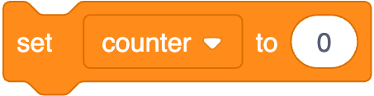
int counter = 0;

Slide 3
int counter = 0;

Slide 4
int counter = 0;

Slide 5
int counter = 0;

Slide 6

counter = counter + 1;

Slide 7
counter = counter + 1;;

Slide 8
counter += 1;

Slide 9
counter++;

Slide 10
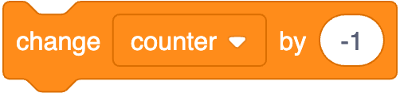
counter--;

Slide 12
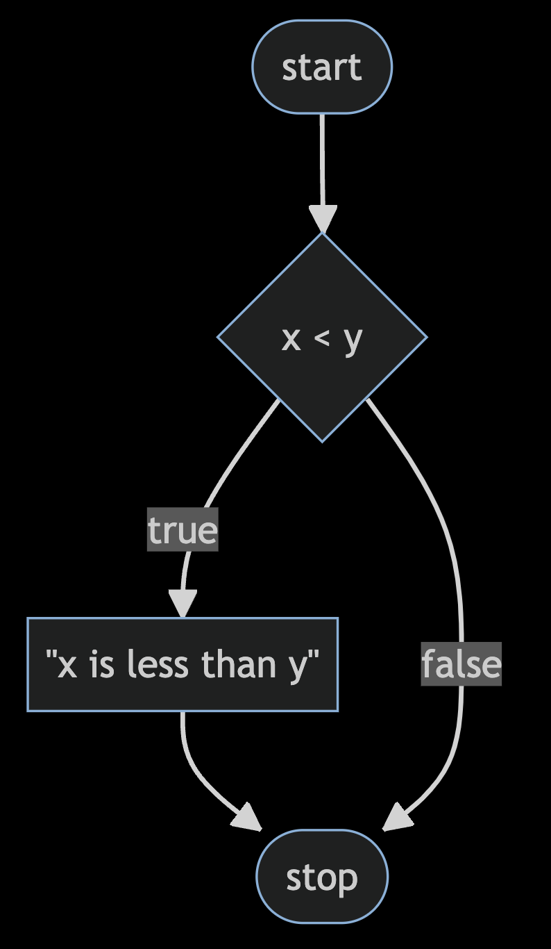

Slide 13
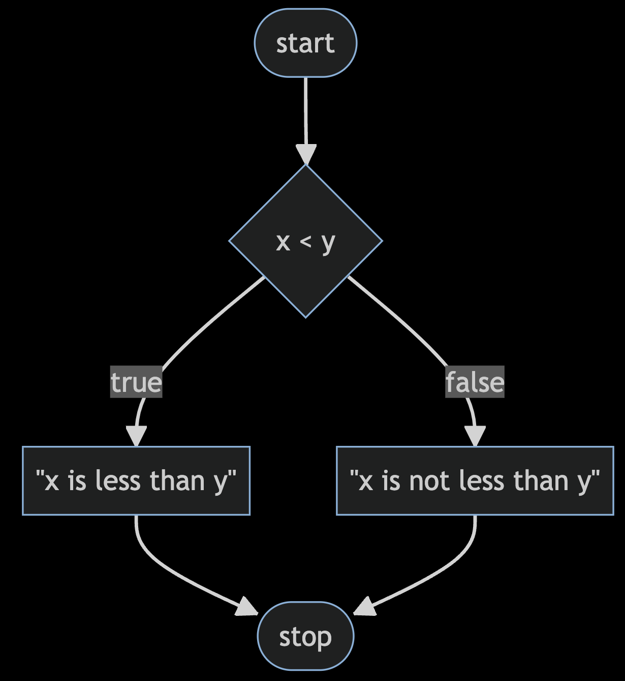

Slide 14
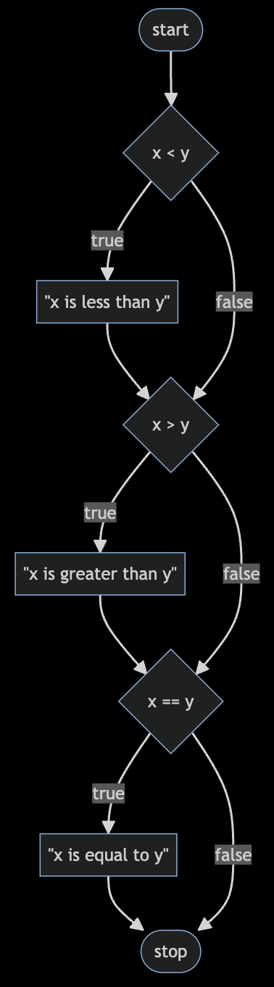

Slide 15
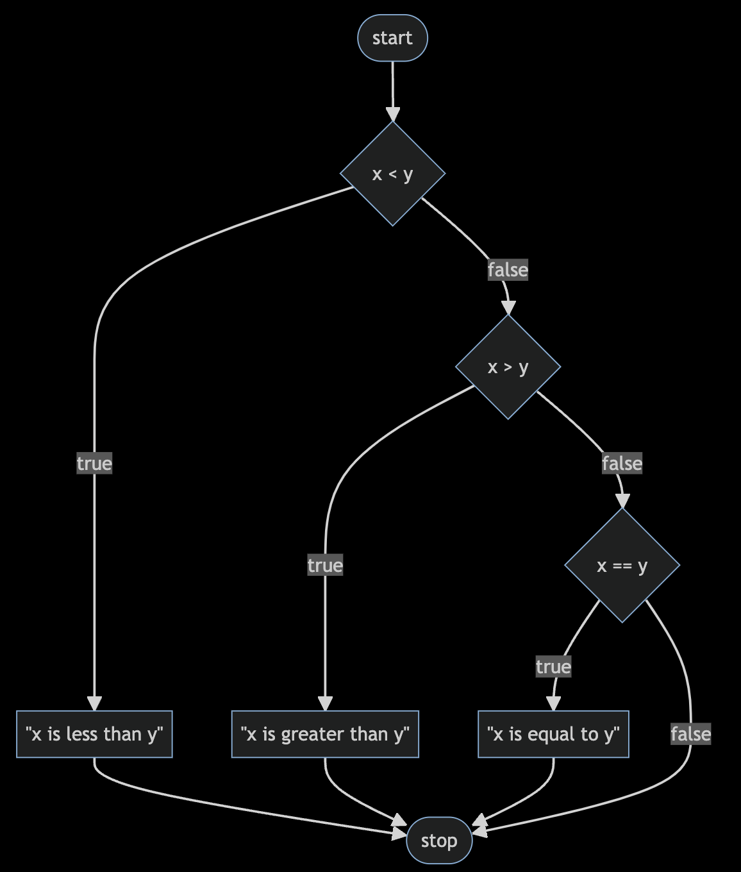

Slide 16
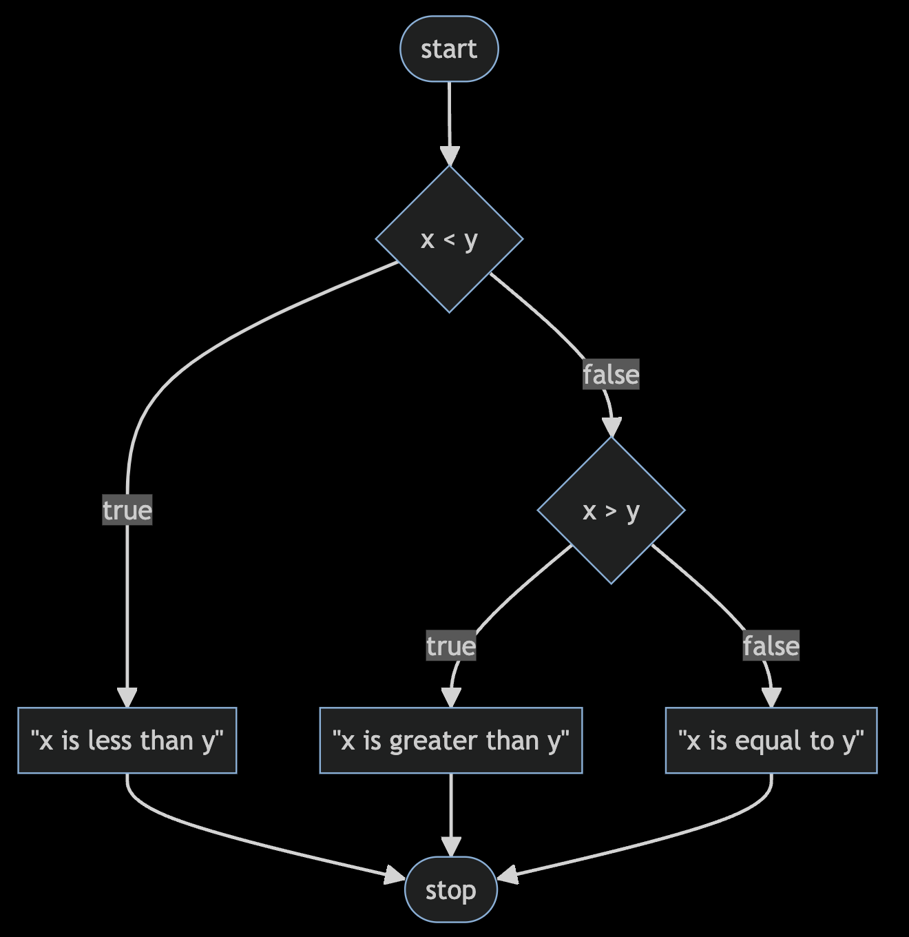

Slide 17
bool
char
double
float
int
long
string
...

Slide 18
bool
char
double
float
int
long
string
...

Slide 19
get_char
get_double
get_float
get_int
get_long
get_string
...

Slide 20
get_char
get_double
get_float
get_int
get_long
get_string
...

Slide 21
loops

Slide 22
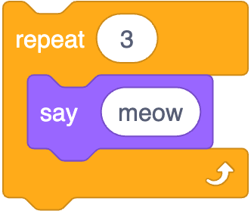

Slide 23
int counter = 3;
while (counter > 0)
{
printf("meow\n");
counter = counter - 1;
}

Slide 24
int counter = 3;
while (counter > 0)
{
printf("meow\n");
counter = counter - 1;
}

Slide 25
int counter = 3;
while (counter > 0)
{
printf("meow\n");
counter = counter - 1;
}

Slide 26
int counter = 3;
while (counter > 0)
{
printf("meow\n");
counter = counter - 1;
}

Slide 27
int counter = 3;
while (counter > 0)
{
printf("meow\n");
counter = counter - 1;
}

Slide 28
int counter = 3;
while (counter > 0)
{
printf("meow\n");
counter = counter - 1;
}

Slide 29
int counter = 3;
while (counter > 0)
{
printf("meow\n");
counter = counter - 1;
}

Slide 30
int counter = 3;
while (counter > 0)
{
printf("meow\n");
counter = counter - 1;
}

Slide 31
int counter = 3;
while (counter > 0)
{
printf("meow\n");
counter = counter - 1;
}

Slide 32
int counter = 3;
while (counter > 0)
{
printf("meow\n");
counter = counter - 1;
}

Slide 33
int counter = 3;
while (counter > 0)
{
printf("meow\n");
counter = counter - 1;
}

Slide 34
int counter = 3;
while (counter > 0)
{
printf("meow\n");
counter = counter - 1;
}

Slide 35
int counter = 3;
while (counter > 0)
{
printf("meow\n");
counter = counter - 1;
}

Slide 36
int counter = 3;
while (counter > 0)
{
printf("meow\n");
counter = counter - 1;
}

Slide 37
int i = 3;
while (i > 0)
{
printf("meow\n");
i = i - 1;
}

Slide 38
int i = 3;
while (i > 0)
{
printf("meow\n");
i -= 1;
}

Slide 39
int i = 3;
while (i > 0)
{
printf("meow\n");
i--;
}

Slide 40
int i = 3;
while (i > 0)
{
printf("meow\n");
i--;
}

Slide 41
int i = 1;
while (i <= 3)
{
printf("meow\n");
i++;
}

Slide 42
int i = 0;
while (i < 3)
{
printf("meow\n");
i++;
}

Slide 43
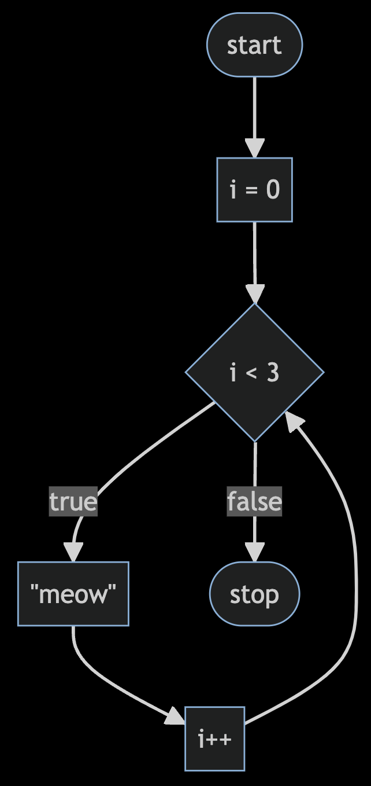

Slide 44
int i = 0;
while (i < 3)
{
printf("meow\n");
i++;
}

Slide 45
for (int i = 0; i < 3; i++)
{
printf("meow\n");
}

Slide 46
for (int i = 0; i < 3; i++)
{
printf("meow\n");
}

Slide 47
for (int i = 0; i < 3; i++)
{
printf("meow\n");
}

Slide 48
for (int i = 0; i < 3; i++)
{
printf("meow\n");
}

Slide 49
for (int i = 0; i < 3; i++)
{
printf("meow\n");
}

Slide 50
for (int i = 0; i < 3; i++)
{
printf("meow\n");
}

Slide 51
for (int i = 0; i < 3; i++)
{
printf("meow\n");
}

Slide 52
for (int i = 0; i < 3; i++)
{
printf("meow\n");
}

Slide 53
for (int i = 0; i < 3; i++)
{
printf("meow\n");
}

Slide 54
for (int i = 0; i < 3; i++)
{
printf("meow\n");
}

Slide 55
for (int i = 0; i < 3; i++)
{
printf("meow\n");
}

Slide 56
for (int i = 0; i < 3; i++)
{
printf("meow\n");
}

Slide 57
for (int i = 0; i < 3; i++)
{
printf("meow\n");
}

Slide 59
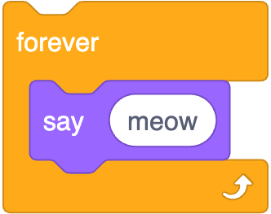
while (true)
{
printf("meow\n");
}

Slide 60
while ( )
{
}

Slide 61
while (true)
{
}

Slide 62
while (true)
{
printf("meow\n");
}

